Slide 1
Getting Started with Jenkins
SETTING UP A JENKINS LEARNING ENVIRONMENT

Slide 2
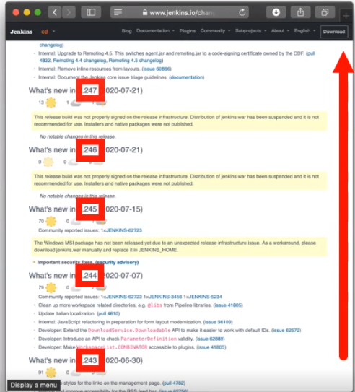
Jenkins Releases
Weekly Releases

Slide 3
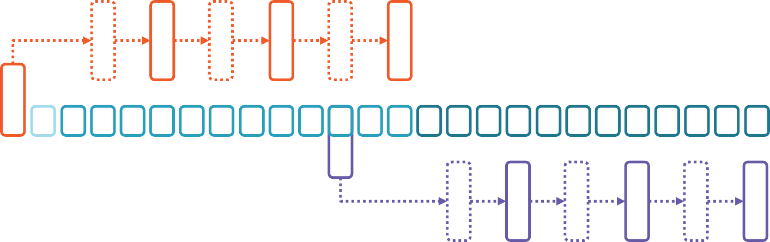
Jenkins Releases
LTS Releases
.1 RC
.1
.2 RC
.2
.3 RC
.3
Weekly Releases
.1 RC
.1
,2 RC
.2
.3 RC
.3
LTS Releases

